Slide 1
Cloud USB HID Firmware Development

Slide 2
USB HID to change Bluetooth device name workflow diagram
HID Terminal.exe From ST Developing tool
NAME
(HOST PC)
USB_HID Protocol
MCU Buffer
Memory
BTM Flash Memory
UART Transport
HID Terminal PC APP
Process Data Block
UART Command 0x05
Put the new name into the USB HID Terminal Box and Send
Driver-less USB Protocol
Firmware role

Slide 3
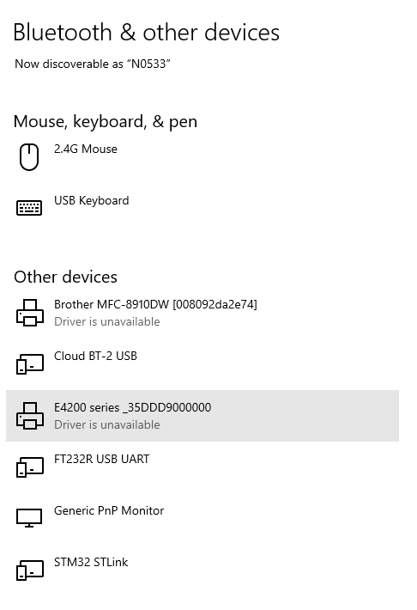
USB Device PC Connection
After connecting the USB from MCU to the PC.
We will see the USB Device Name “Cloud BT-2 USB”
These are USB HID devices.
User doesn’t need to install USB Driver (USB HID Class advantage)

Slide 4
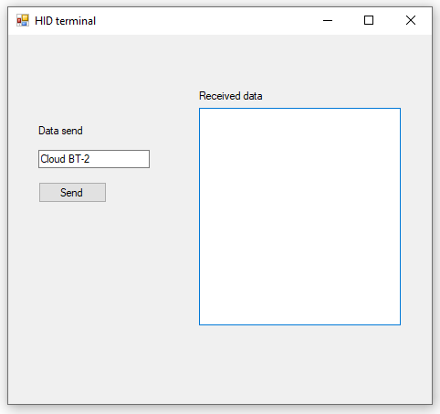
ST HID Terminal (PC Software)
Put string data of the new name that desire into the “data send” box
EX: fill in the box with “Cloud BT-2”
SMT will not develop on PC Application software

Slide 5
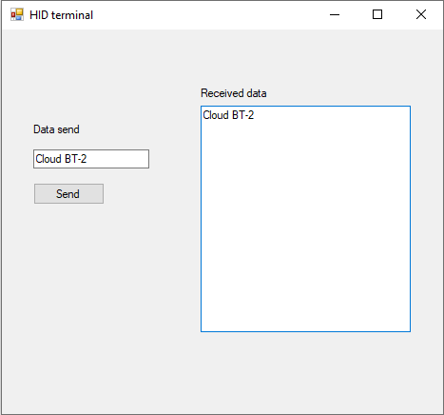
ST HID Terminal (PC Software)
After Click on “Send" button, we will see on “Received data” box they return data that was sent before.
Send
SMT will not develop on PC Application software

Slide 6
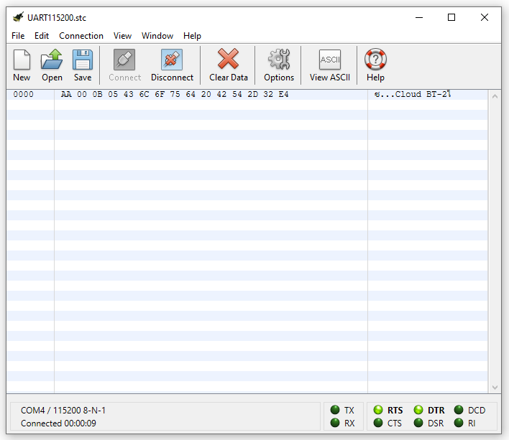
Serial Terminal Software
If we observe with the Serial Terminal debugger we will see UART Packet Command (HEX DATA) was transmitted by MCU after put “string” in the box and clicking send button

Slide 7
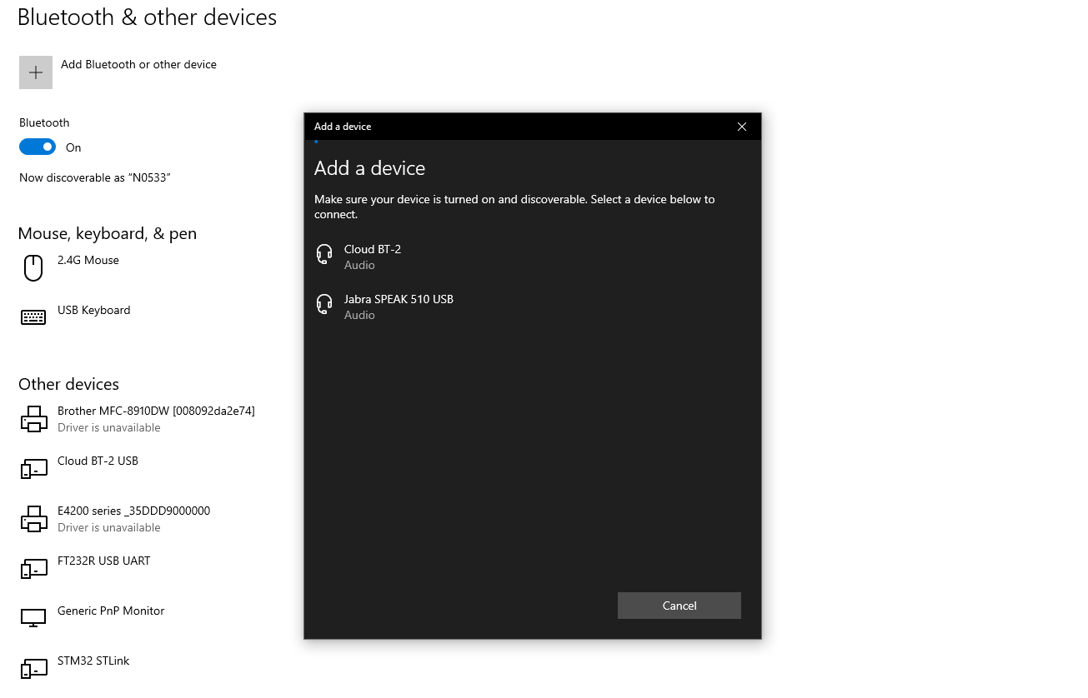
Bluetooth devices discovery on (PC)
On PC, LAPTOP
Go to Bluetooth & other devices from the PC Start bar
Click on Add Bluetooth or other devices
Then click Bluetooth
We will see the name of the Bluetooth device appear.
“Cloud BT-2”

Slide 8
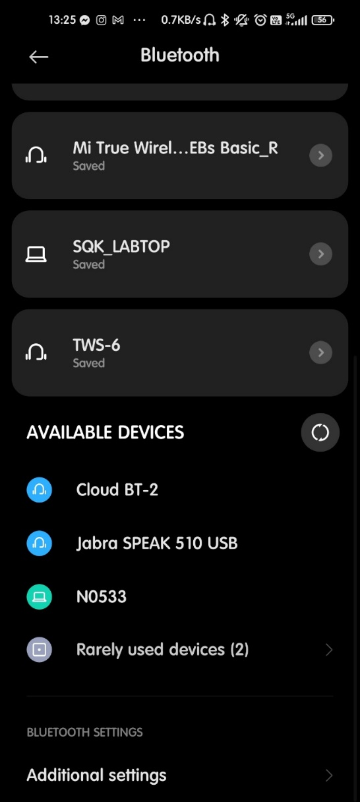
Bluetooth devices discovery on (Mobile)
And we will see the name of the Bluetooth device is appear on a mobile device at the same name.
“Cloud BT-2”

